Slide 1
Galarm
“Rise and Earn”
Notes:
Lead off with a very quick introduction of yourself including name, class year, school and major [15 seconds]

Slide 2
The Team
John Park (Class of 2021)
John is a 2nd year student majoring in Computer Science and minoring in Electrical & Computer Engineering in the College of Engineering. His interests include machine learning, artificial intelligence, and software engineering.
Nikolas Cruz-Marsted (Class of 2021)
Niko is a 2nd year student studying Computer Science in the College of Arts and Sciences. He worked at Amazon last summer on the marketplace si
Anthony Peraza (Class of 2021)
Anthony is a sophomore studying Operations Research and Information Engineering with a Computer Science minor. He is very interested in entrepreneurship and data science.
Echo Li (Class of 2022)
Echo is a freshman in the College of Arts and Sciences studying Economics.

Slide 3
Executive Summary
01
Situation and Problem
The Opportunity
Current System
02
Our Solution
Our Concept
Benefits
Productive Momentum
03
Business Model
Business Model
Competition
04
The Market
Potential Market
Estimated Revenue
05
Roadmap
Timeline
Looking Ahead

Slide 4

Problem Statement
58% of Americans spend more than 5 minutes in bed each morning.
Cornell students are no exception
Waking up and facing daunting responsibilities i.e. prelims, papers, interviews.
This can induce procrastination and impede productivity
Notes:
http://www.sleepreviewmag.com/2014/08/americans-snooze-button-withings/

Slide 5
The Solution: Get Paid to Wake Up
Galarm is an alarm clock that can earn value for anyone at Cornell: waking up to go to class
As the advancement of AI and Machine Learning speeds up across the globe, more and more researchers and companies are seeking out people to do simple, menial tasks in order to help either validate or train ML models.
What Galarm seeks to do is integrate those tasks into an alarm clock: users get paid to do these tasks as they wake up and clients receive daily data at low cost.
Wake Up
Complete Small Tasks
Earn and Start Your Day
Notes:
Introduce your idea and the solution you're bringing to the world to address the problem. [30 seconds]
Galarm is an alarm clock that earns value from something every single person in the world does every single day: wake up. As the advancement of AI and Machine Learning speeds up across the globe, more and more companies are seeking out people to do simple, menial tasks in order to help either validate or train ML models. What Galarm seeks to do is integrate those tasks into an alarm clock, where users get paid to do

Slide 6
User Benefits
Productive Momentum
No More Wasted Time
Earn

Slide 7
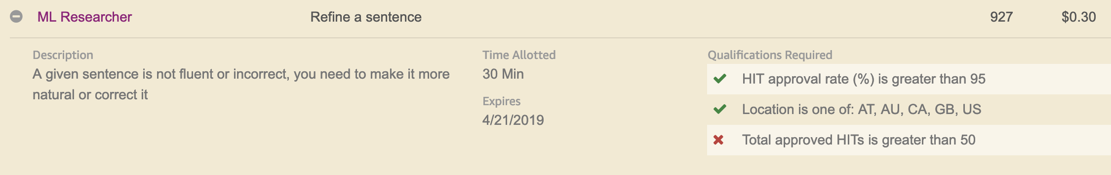
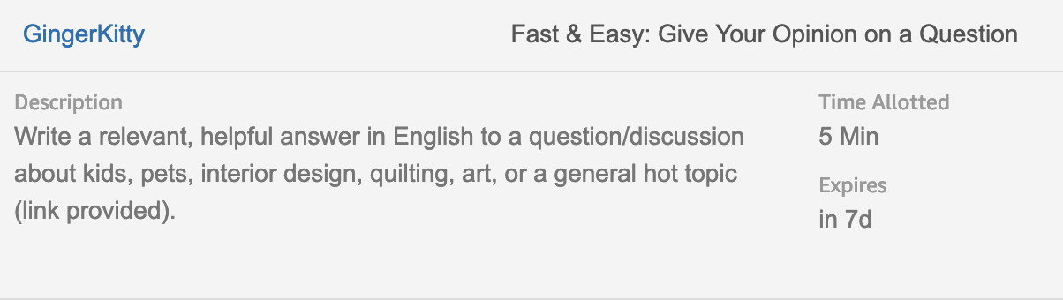
The Business Model
Researchers (including CU Professors) and ML companies pay for human computation.
We connect those entities to a willing workforce.
Symbiotically create value for users and researchers.
Notes:
What is the business model? How will you generate revenue for this idea to sustain and grow? [15 seconds]
Potentially, the tasks could be expanded to meet the needs of any company that might need training for machine-learning models, as
once the user base grows significantly, we would be able to offer a large amount of training data to anyone that needs it.

Slide 8
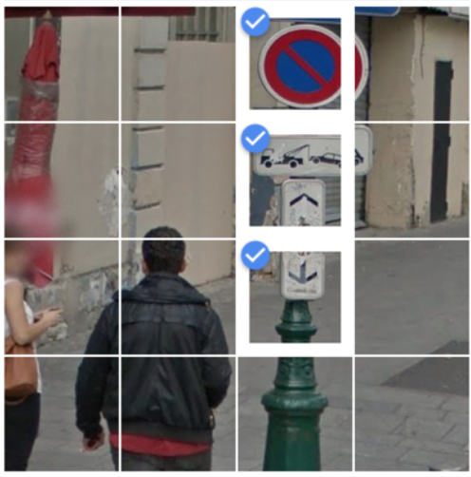
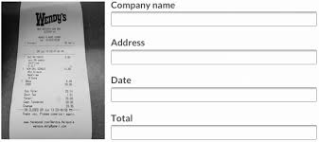
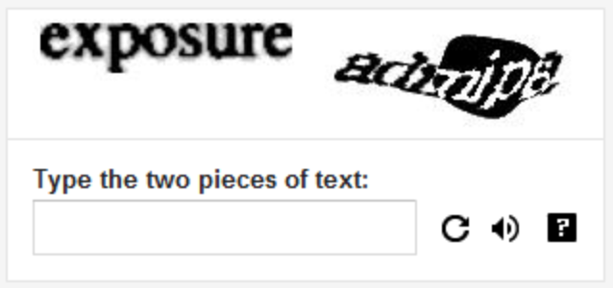
Example Requests
Requesting transcription of a receipt
Requesting image verification
Requesting text transcription

Slide 9

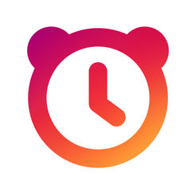
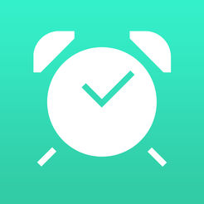

The Competition
Client Side:
Alarm apps that ask users to solve puzzles or small math questions
Alarmy
I Can’t Wake Up!
Server Side:
Platforms that exist where clients can request human review of data:
Clickworker
Amazon Mechanical Turk
Notes:
Who else is doing this? Competitive landscape. Don’t say "no one", acknowledge competitor or most competitive in your space. [15 seconds]

Slide 10
Potential Market
30% of total market share:
6,214 student users
1
90% of Cornell uses smartphones:
20,714
2
Total 23,016 Cornell Student Population
3

Slide 11
Estimated Revenue
The tasks have a range of value from $0.01 to $0.20
*Assuming the we get the same distribution of questions as Amazon Mechanical Turk*
The Average value per task is $0.05
30% of market share $165,016 Annual Revenue (Cornell)
 | Undergraduate | Graduate | Total
Cornell University | 14,907 | 8,109 | 23,016
Across the U.S. | 22.2 Million | 1.98 Million | 24.18 Million
Notes:
How did you get the number 165,016?

Slide 12

Roadmap
Customer Research
App Development & Design
Launch Beta
Publication
Develop Marketing Plan
Gather input requests

Slide 13
Conclusion
Thank you for your time
Questions
Notes:
Conclusion slide with thank you. [10 seconds]

